Slide 1
Applets

Slide 2
Applets
Introduction
Local & Remote Applets
How Applets differ from Applications
When to use applets
Applet Life Cycle
Applet Restrictions
Applet Programming

Slide 3
Introduction
Types of Java Programs
There are three kinds of Java programs:
    Applications
    Applets
    Libraries
An application is a Java program that is run by using a Java interpreter program.
An applet is a Java program that is run by a Java-enabled web browser.
A library is a set of Java classes that can be used by another Java program.

Slide 4
Java Applet vs. JavaScript
Both similar and quite different
Java Applet | JavaScript
Created by Sun | Created by Netscape
Standalone application Developed outside out of HTML | text that is fed into a browser that can read it and then is enacted by the browser.
Must be converted into machine language before it can be run on the web | Text based, not need to be compiled
Once it is compiled, it is set. Have to go back to the original text and alter it, then compile again. | Can be altered after it runs and run it again and again

Slide 5
Applets are small Java programs that are primarily used in Internet computing.
Applets can be transported over the Internet from one computer to another and run using the Applet Viewer or any Web browser that supports Java.
Applets can perform arithmetic operations, display graphics, play sounds, accepts user input, create animation and play interactive games.
A web page can now contain not only a simple text or a static image but also a Java Applet, which when run can produce graphics, sounds and moving images.
Therefore. Java applets have begun to make a significant impact on World Wide Web.

Slide 6
Local & Remote Applets
We can embed applets into Web pages in 2 ways :
      We can write our own applets & embed them into Web pages.
      We can download an applet from a remote computer system and then embed it into a Web page.

Slide 7
Local Applet
An applet developed locally and stored in a local system is known as a local applet.
When a Web page is trying to find a local applet, it does not need to use the Internet & therefore the local system does not require the Internet connection.
It simply searches the directories in the local system and locates and loads the specified applet.

Slide 8
Remote Applet
A remote applet is that which is developed by someone else and stored on a remote computer connected to the Internet.
We can download the remote applet onto our system via the Internet & run it by connecting the system to Internet.
In order to locate and load a remote applet, we must know the applet’s address on the Web. This address is known as URL and must be specified in the applet’s HTML document as follows:
CODEBASE = http: // www.netserve.com/ applets

Slide 9
How Applets differ from Applications
Applets do not use the main() method for initiating the execution of the code. Applets, when loaded, automatically call certain methods of Applet class to start and execute the applet code.
Unlike stand-alone applications, applets cannot be run independently.They are run from inside a Web page using a special feature known as HTML tag.
Applets cannot read from or write to the files in the local computer.
Applets cannot communicate with other servers on the network.
Applets cannot run any program from the local computer.
Applets are restricted from using libraries from other languages such as C or C++.

Slide 10
When to use applets
When we need something dynamic to be included in the display of a Web page.
When we require some “flash” outputs.
When we want to create a program and make it available on the Internet for us by others on their computers.

Slide 11
Steps involved in developing and testing are :
Building an applet code (.java file)
Creating an executable applet (.class file)
Designing a Web page using HTML tags.
Preparing <APPLET> tag.
Incorporating <APPLET> tag into the Web page.
Creating HTML file.
Testing the applet code.

Slide 12
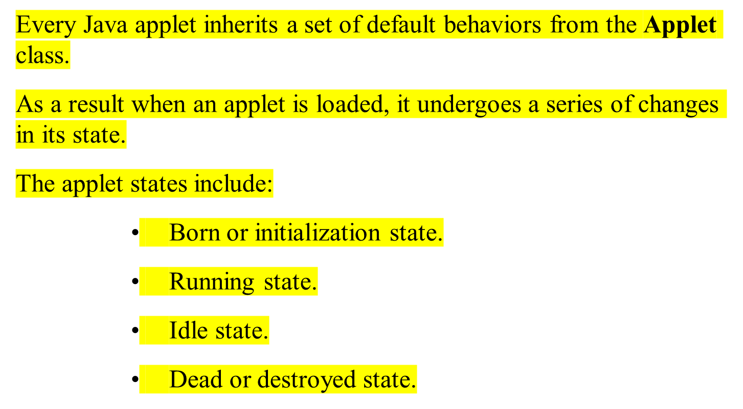
Applet Life Cycle

Slide 13
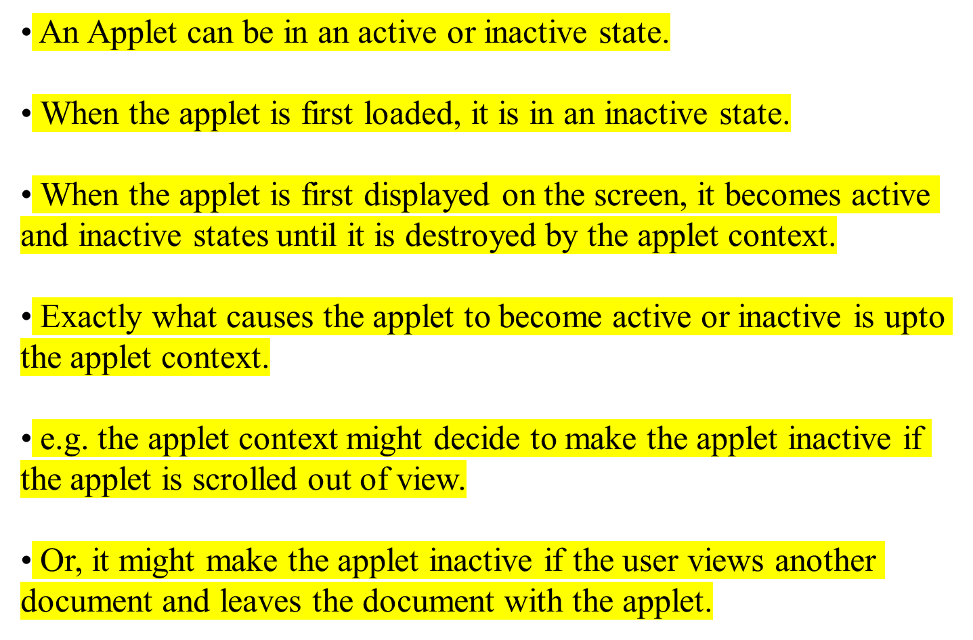

Slide 14
Born
Initialization
Begin
(Load Applet)
start()
stop()
Running
Idle
Stopped
Display
start()
paint()
destroy()
Dead
End
Destroyed
An applet’s state transition diagram

Slide 15
Initialization State :
Applet enters the initialization state when it is first loaded.
Achieved by calling the init() method of Applet class.
Applet is born.
At this stage, we can
  Create objects needed by the applet
  set up initial values
  load images or fonts
  set up colors
Occurs only once in the applet’s life cycle.
To provide any of the above behavior, we must override the init() method:
        public void init()
        { ------Action------- }

Slide 16
Running State :
Applet enters the running state when the system calls the start() method of Applet class.
Occurs automatically after the applet is initialized. Starting can also occur if the applet is already in Idle state.
Unlike init() method, the start method may be called more than once.
We may override the start() method to create a thread to control the applet.
        public void start()
        {
        -------------
        ------------- (Action)
        }

Slide 17
Idle or Stopped State :
An applet becomes idle when it is stopped from running.
Occurs automatically when we leave the page containing the currently running applet. We can also do so by calling the stop() method explicitly.
If we use a thread to run the applet, then we must use stop() method to terminate the thread.
We can achieve this by overriding the stop() method as:
        public void stop()
        {
        -------------
        ------------- (Action)
        }

Slide 18
Dead State :
An applet is said to be dead when it is removed from memory.
Occurs automatically by invoking the destroy() method when we quit the browser.
Like initialization, destroying stage occurs only once in the applet’s life cycle.
We may override the destroy() method as :
        public void destroy()
        {
        -------------
        ------------- (Action)
        }

Slide 19
Display State :
Applet moves to the display state whenever it has to perform some output operations on the screen.
Happens immediately after the applet enters into the running state.
The paint() method is called to accomplish this task. Almost every applet will have a paint() method.
Like other methods in the life cycle, the default version of paint() method does absolutely nothing.
We must override this method if we want anything to be displayed on the screen.
        public void paint(Graphics g)
        {
        -------------
        ------------- (Action)
        }

Slide 20
Applet Restrictions
Applets can never run any local executable program.
Applets cannot communicate with any host other than the server from which they were downloaded.
Applets cannot read or write to local computers file system.
Applets cannot find any information about local computer except for Java Version used, name and version of operating system. In particular applets cannot find out user’s name, email address etc.
All these restrictions & limitations are placed in the interest of security of systems.These restrictions ensure that an applet cannot do any damage to the local system.

Slide 21
Java Applet Template
import java.awt.*;
import java.applet.*;
public class AppletName extends Applet {
      /* Applet description. */
public void paint(Graphics graphics) {
/* applet display statements go here. */
}
}
put display statements here

Slide 22
import java.awt.*;
import java.applet.*;
public class WelcomeApplet extends Applet {
public void init() {
}
public void paint(Graphics g) {
g.drawString("Welcome to Java Programming!", 25, 25 );
}
}
extends allows us to inherit the capabilities of class Applet.
Method paint is guaranteed to be called in all applets.

Slide 23
Creating an Executable Applet
Executable applet is nothing but the .class file of the applet, which is obtained by compiling the source code of the applet.
Compiling an applet is exactly the same as compiling an application.
Steps required for compiling an applet :
Move to the directory containing the source code and type the following command :
Javac HelloJava.java
The compiled output file called HelloJava.class is placed in the same directory as the source.
If any error message is received, then we must check for errors, correct them and compile the applet again.

Slide 24
Designing a Web Page
A Web page is basically made up of text and HTML tags that can be interpreted by a Web browser or an applet viewer.
Web pages should be stored in the same directory as the compiled code of the applets.
Web page template:
<HTML>
</HTML>
  <!
  ……………………
  ……………………
  >
Comment Section
  <HEAD>
  </HEAD>
Head Section
Title Tag
  <BODY>
  </BODY>
Body Section
Applet Tag

Slide 25
Adding Applet to HTML File
<HTML>
<! Web page displaying Title, Message and
specifying the applet to be loaded & executed.>
<HEAD>
<TITLE> Welcome to Java Applets </TITLE>
</HEAD>
<BODY>
<CENTER>
<H1> Welcome to the World of Applets </H1>
<BR>
</CENTER>
<CENTER>
<APPLET
CODE = HelloJava.class
WIDTH = 400
HEIGHT = 200>
</APPLET>
<CENTER>
</BODY>
</HTML>

Slide 26
Running the Applet
We must have the following files in our current directory :
HelloJava.java
HelloJava.class
HelloJava.html
To run an applet, we require one of the following tools:
1. Java-enabled Web browser (Such as HotJava or Netscape)
2. Java appletviewer
If we use a Java-enabled Web browser, we will be able to see the entire Web page containing the applet.
If we use the appletviewer tool, we will only see the applet output.
The appletviewer is not a full-fledged Web browser.
We can use it to run our applet as follows :
appletviewer HelloJava.html

Slide 27
Applet Tag with all attributes
<APPLET
[ CODEBASE = codebase_URL ]
CODE = AppletFileName.class
[ ALT = alternate_text ]
[ NAME = applet_instance_name ]
WIDTH = pixels
HEIGHT = pixels
[ ALIGN = alignments ]
[ VSPACE = pixels ]
[ HSPACE = pixels ]
>
[ < PARAM NAME = name1 VALUE = value1> ]
[ < PARAM NAME = name2 VALUE = value2> ]
…………………….
…………………….
</APPLET>

Slide 28
Passing Parameters to Applets
We can supply user-defined parameters to an applet using <PARAM…> tags.
Each <PARAM> tag has a name attribute such as color,
and a value attribute such as red.
e.g. We can change the color of the text displayed to red by an applet by using a <PARAM…> tag as follows:
<APPLET …..>
<PARAM NAME= color VALUE = “red”>
</APPLET>

Slide 29
To set up and handle parameters, we need to do two things :
Include appropriate <PARAM…> tags in the HTML document.
Provide code in the applet to parse these parameters.
Parameters are passed to an applet when it is loaded.
We can define the init() method in the applet to get hold of the parameters defined in the <PARAM> tags.
This is done using the getParameter() method, which takes one string argument representing the name of the parameter and returns a string containing the value of the parameter.

Slide 30
Displaying Numerical Values
In applets, we can display numerical values by first converting them into strings and then using the drawString() method of Graphics class.
We can do this easily by calling the ValueOf() method of String class.

Slide 31
Getting Input From the User
Applets work in a graphical environments. Hence, applets treat inputs as text strings.
The TextField class of the applet package, is used to create the area on the screen where the user can type the values & edit them, if necessary.
t1 = new TextField(8);
add(t1);
Next step is to retrieve the items from the fields for calculations.
s1 = t1.getText();
Data in text field is in string form which need to be converted to the right form, before using it in any computation. x = Integer.parseInt(s1);
  z = x * x;
The results are then converted back to strings for display.
s = String.valueOf(z);

Slide 32
Applet class hierarchy
Class Applet
java.lang.Object
| +--java.awt.Component
| +--java.awt.Container
| +--java.awt.Panel
| +--java.applet.Applet
Java.applet package contains only one class & three Interfaces
1.AppletContext
2.AppletStub
3.AudioClip

Slide 33
The java.applet Package
The java.applet package defines the Applet class and the AppletContext, AppletStub and the AudioClip interface.
Applet class provides all necessary support for applet execution, such as starting & stopping.
It also provides methods that load & display images, and methods that load & play audio clips.
The Applet class defines the methods as follows :

Slide 34
The Applet class defines the methods as follows :
AppletContext getAppletContext() – Returns the context associated with the applet.
String getAppletInfo() – Returns a string that describes the applet.
URL getCodeBase() – Returns the URL associated with the invoking applet.
URL getDocumentBase() – Returns the URL of the HTML document that invokes the applet.
String getParameter(String paramName) – Returns the parameter associated with paramName.
String[][] getParameterInfo() – Returns a String table that describes the parameters recognized by the applet.

Slide 35
AudioClip getAudioClip(URL url) - Returns an AudioClip object that encapsulates the audio clip found at the location specified by url.
AudioClip getAudioClip(URL url, String clipName) – Returns an AudioClip object that encapsulates the audio clip found at the location specified by url and having the name specified by clipName.
Image getImage(URL url) - Returns an Image object that encapsulates the image found at the location specified by url.
Image getImage(URL url, String imageName) - Returns an Image object that encapsulates the image found at the location specified by url and having the name specified by imageName.

Slide 36
boolean isActive() - Returns true if the applet has been started & returns false if the applet has been stopped.
void resize(int width, int height) – Resizes the applet according to the dimensions specified by width & height.
void play(URL url) – If an audio clip is found at the location specified by url, the clip is played.
void play(URL url, String clipName) – If an audio clip is found at the location specified by url with the name specified by clipName, the clip is played.

Slide 37
Graphics Class
Graphics class is in java.awt package. This class contains methods for drawing strings,lines, basic shapes and images.
This class provides a coordinate scheme to draw that thing on a particular position in your applet.
A few methods are :
drawLine(int x1, int y1, int x2, int y2) ;
drawRect(x,y,width,height);
fillOval(x,y,width,height);
drawImage(img, int x, int y, int width, int height, ref);

Slide 38
Font Class
Font class is in java.awt package. This class provides you the wide variety of font faces, styles and sizes.
You can make a object of Font class to make a font of your choice.
Font f=new Font(String name,int style,int size);
*Name of the font may be any available font name.
*Style is a predefined int static values in Font class like BOLD, ITALIC, PLAIN. You can use it like-> Font.BOLD
A combination is also possible-> Font.BOLD+Font.ITALIC
*Size is simply the font size.
Using font g.setFont(f);

Slide 39
Color Class
Color class is in java.awt package. The constructor of this class provides you the wide variety of colors.
You can make a object of color class to make a color of your choice.
Color c=new Color(Color.red);
Color c=new Color(int r,int g,int b);
Color c=new Color(int rgb);
There are static int values defined for common colors.
Applet can use this colors like->
setBackground(Color.color);
setForeground(new Color(30,50,255));

Slide 40
Typical UI components
  Buttons (java.awt.Button)
  Checkboxes(java.awt.Checkbox)
  Simple Text (java.awt.TextField)
  Larger text, editing areas (java.awt.TextArea)
  Labels (java.awt.List)
  Popup lists (java.awt.Choice)
  Sliders, scrollbars (java.awt.Scrollbar)
  Drawing areas (java.awt.Canvas)
  Menus(java.awt.Menu,java.awt.MenuItem,java.awt.CheckboxMenuItem)
  Containers (java.awt.Panel, java.awt.Window)
Adding GUI component methods (Applet extends Container)

Slide 41
Ex
public boolean action(Event evt, Object arg)
{
if (evt.target instanceof Button)
{
if (arg == "red")
{
c=new Color(255,0,0);
repaint();
}
}
return true;
}
}
import java.awt.*;
import java.applet.*;
/*<applet code=AppletAction.class height=400 width=400>
</applet>*/
public class AppletAction extends Applet
{
Button b;
Color c;
public void init()
{
b=new Button("Red");
add(b);
c=new Color(0,255,0);
}
public void paint(Graphics g)
{
setBackground(c);
}

Slide 42
Layout Managers
Java’s layout managers provide a level of abstraction to automatically map your user interface on all window systems.
The UI components are placed in containers. Each container has a layout manager to arrange the UI components within the container.

Slide 43
Kinds of Layout Managers
FlowLayout
GridLayout
BorderLayout
CardLayout
GridBagLayout

Slide 44
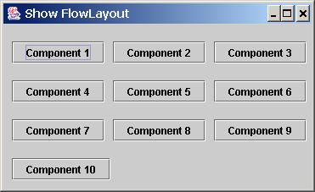
Example FlowLayout Manager
The components are arranged in the container from left to right in the order in which they were added. When one row becomes filled, a new row is started.

Slide 45
FlowLayout Constructors
public FlowLayout(int align, int hGap, int vGap)
Constructs a new FlowLayout with a specified alignment, horizontal gap, and vertical gap. The gaps are the distances in pixel between components.
public FlowLayout(int alignment)
Constructs a new FlowLayout with a specified alignment and a default gap of five pixels for both horizontal and vertical.
public FlowLayout()
Constructs a new FlowLayout with a default
center alignment and a default gap of five pixels
for both horizontal and vertical.

Slide 46
GridLayout Manager
The GridLayout manager arranges components
in a grid (matrix) formation with the number of
rows and columns defined by the constructor. The components are placed in the grid from left to right starting with the first row, then the second, and so on.

Slide 47
GridLayout Constructors
public GridLayout(int rows,
int columns)
Constructs a new GridLayout with the specified number of rows and columns.
public GridLayout(int rows, int columns, int hGap, int vGap)
Constructs a new GridLayout with the
specified number of rows and columns,
along with specified horizontal and
vertical gaps between components.

Slide 48
BorderLayout Manager
The BorderLayout manager divides the container into five areas: East, South, West, North, and Center. Components are added to a BorderLayout by using the add method.
add(Component, constraint), where constraint is BorderLayout.EAST, BorderLayout.SOUTH, BorderLayout.WEST, BorderLayout.NORTH, or BorderLayout.CENTER.

Slide 49
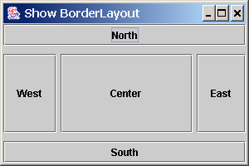
Ex. Border Layout

